Slide 1
Helping Hospice Patients leave a Legacy

Slide 2

A lasting legacy
Donation of sight and health is one of the most meaningful gifts a person can give
Creates a lasting personal legacy for patients and families
Supports dignity, autonomy, and end-of-life wishes

Slide 3
Uniform Anatomical Gift Act
We have a responsibility to honor the patient’s wishes
Patient may have already decided to donate
Many have legally designated themselves as donors:
                Driver’s license
                Online registry
                Living will/advance directive

Slide 4
Donation Is Supported by Law
Uniform Anatomical Gift Act (UAGA) enacted throughout the U.S.
Recognizes and protects the altruistic intentions of donors
Donation decisions are legally binding and must be respected

Slide 5
Donation Options
Many hospice patients feel they are too ill to donate
Illness does not automatically disqualify donation
Eligibility is determined by the recovery organization – not hospice staff
Options may include:
        Transplantation
        Research
        Medical Education

Slide 6
Myths & facts about donation
Myth: I’m too sick to donate.
Fact: Many patients remain eligible despite illness.
Myth: Donation will delay funeral arrangements.
Fact: Recovery typically occurs within hours and rarely causes delays.
Myth: My family will not be able to have a viewing.
Fact: Viewings, including open-casket services, are still possible.

Slide 7
Timing matters
Donation discussions must occur before funeral arrangements
If no one knows the patient’s wishes, donation may not happen
Recovery takes place within several hours of death
Early conversations make honoring wishes easier

Slide 8
Encourage open conversations
Encourage patients and families to discuss donation
Discussing donation is not coercion – it is honoring choice
These conversations are often easier before death
Patients should share their wishes with their nurse, social worker, and family.

Slide 9
Hospice staff role
Ask if the patient has considered donation
Document wishes clearly in the medical record
Notify the appropriate recovery organization at time of death
Allow recovery partners to support the family

Slide 10
Hospice staff not responsible for:
Determining eligibility
Coordinating Recovery
Explaining medical suitability

Slide 11

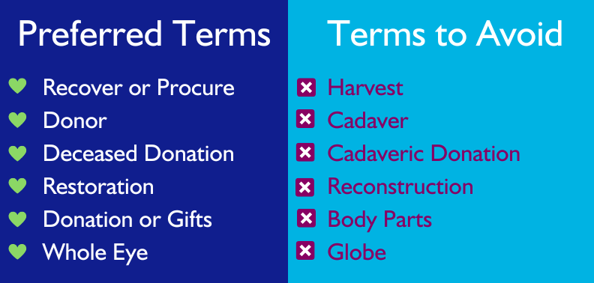
Terminology matters

Slide 12
Benefits for families
Provides meaning and comfort during grief
Helps families feel the patient’s wishes were honored
Can reduce regret and unanswered questions
Creates a lasting legacy through others

Slide 13
Making it happen
When in doubt – REFER
Contact the local recovery organization early
        24/7 support
        Family education
        All donation logistics

Slide 14
Key takeaway
“You only get one chance to honor a patient’s wish to donate. Asking the question makes all the difference.”

